Slide 1
Tutorial 6
T03/08
Goh Rui Zhi
gohruizhi@u.nus.edu

Slide 2
TLS renegotiation

Slide 3
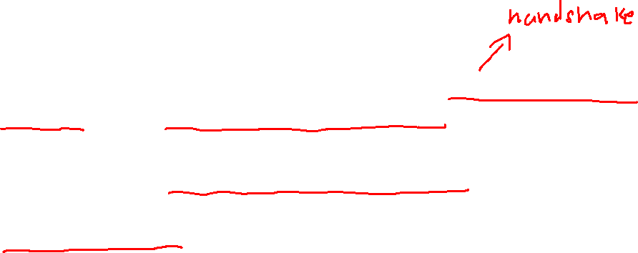
TLS Renegotiation
In the event of a timeout or a disconnection after keys have been exchanged, the TLS renegotiation protocol allows the client to reconnect to the server.
Client would use the previously established session key, to renegotiate new keys for their subsequent communication.
Preserves the session previously established by the client.

Slide 4
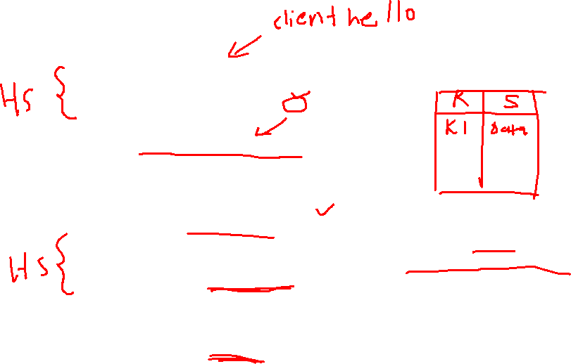
TLS Renegotiation
Initial TLS greetings
Establish session key K1
Normal Communication
Client disconnects/timeouts
Encrypt “Client Hello” using K1
Session retrieves previous session using K1
Establish session key K2
Continue Communication using K2
Client
Server

Slide 5
TLS renegotiation Attack

Slide 6

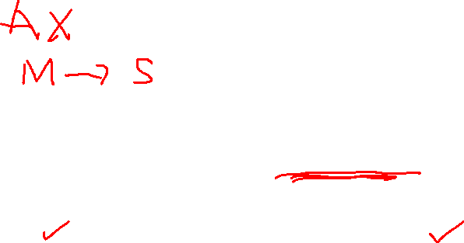
Pre-attack
1. Attacker (Mallory) initialises a TLS handshake with the server (Bob’s Pizzeria).
Client (Mallory) Hello!
Server Hello!
Mallory
Bob’s Pizzeria

Slide 7
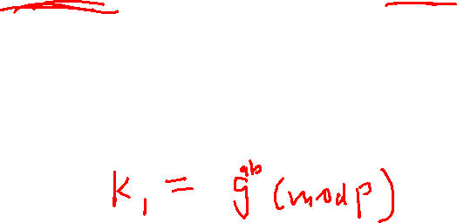
Pre-attack
2. Key exchange (Diffie Hellman). Let’s call the established key, K1.
Here’s my g^{b} (mod p)
Here’s my gª (mod p)
Mallory
Bob’s Pizzeria

Slide 8
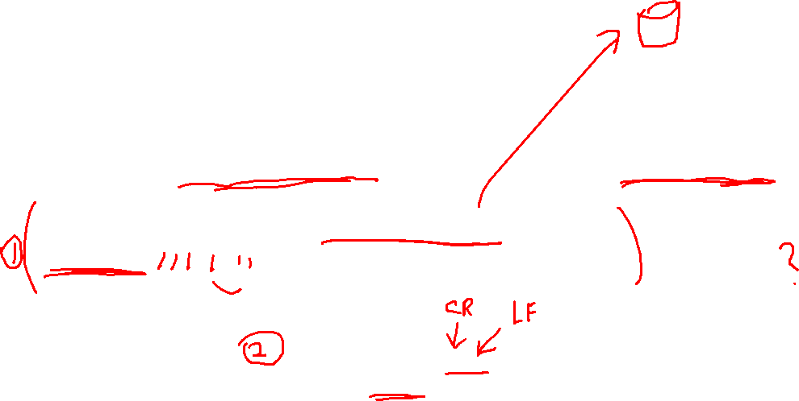
Pre-attack
3. Mallory sends a specially crafted message, encrypted with the established session keys, K1.
GET /pizza?toppings=pineapple; address=malloryaddress HTTP/1.1
X-Ignore-This:
And?
Note that there’s no ‘\r\n’ here.
Request is incomplete, server is
left hanging.
Mallory
Bob’s Pizzeria

Slide 9

The attack
1. Alice also wishes to order from Bob’s Pizzeria, and hence initialises a TLS handshake with Bob. Mallory (MITM) intercepts the hello client message.
Mallory, I’m still waiting for you to complete your request.
Client (Alice) Hello!
Thanks for the message.
Alice
Mallory
Bob’s Pizzeria

Slide 10
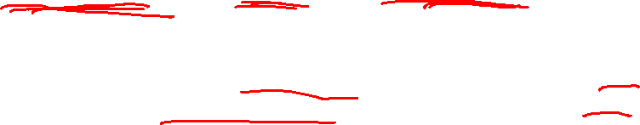
The attack
2. Mallory encrypts Alice’s hello client message with K1 and initiates renegotiation with Bob.
Good to see you back Mallory! You have an incomplete order…
Hey Bob, I had a timeout. Here’s the encrypted new “Client Hello” message.
Alice
Mallory
Bob’s Pizzeria

Slide 11
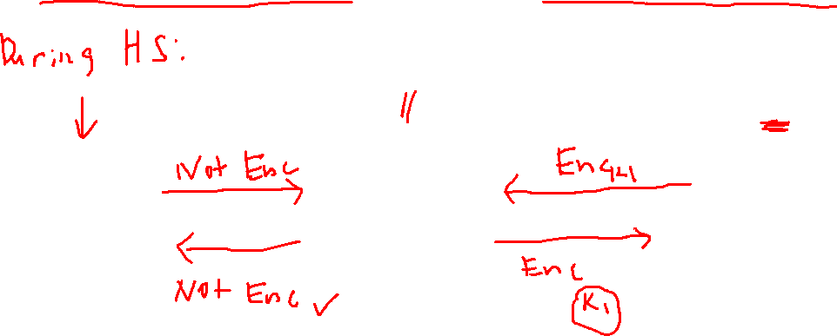
The attack
3. Bob sends back the hello server message. Mallory decrypts it first before forwarding it to Alice
Server Hello
Ek1(Server Hello)
Alice
Mallory
Bob’s Pizzeria

Slide 12
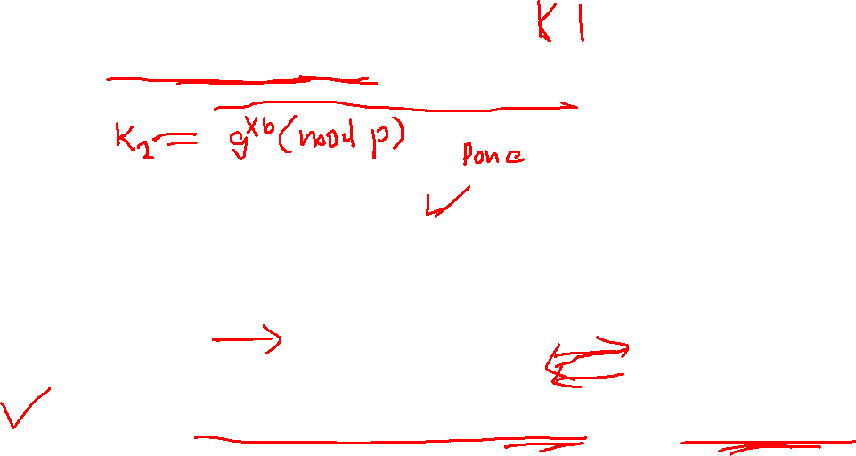
The attack
4. Alice initiates key exchange with Bob. Mallory now just forwards whatever messages between Alice and Bob. Established K2, which Mallory doesn’t know.
Let’s use K2 as our session key
Okay.
Alice
Mallory
Bob’s Pizzeria
*From this point, all communication is encrypted using the new key, which Mallory doesn’t know.

Slide 13
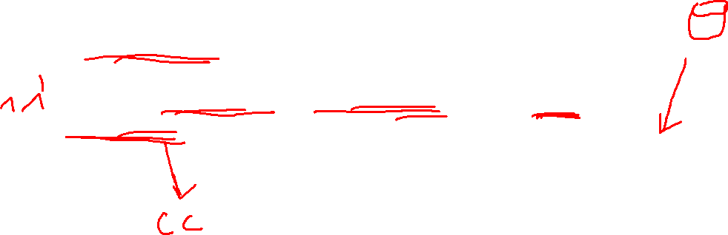
The attack
5. After k2 is established, Alice sends her encrypted request.
GET /pizza?toppings=pepperoni; address=aliceaddress HTTP/1.1 \r\n
Cookie: Alicecookie
Alice
Mallory
Bob’s Pizzeria

Slide 14
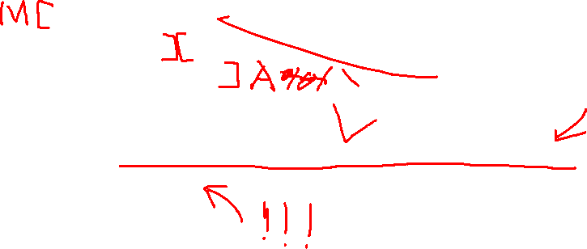
What is the effect of this?
Full request that Bob received:
GET /pizza?toppings=pineapple; address=malloryaddress HTTP/1.1 X-Ignore-This:GET /pizza?toppings=pepperoni; address=aliceaddress HTTP/1.1 Cookie: alicecookie
Which is effectively:
GET /pizza?toppings=pineapple; address=malloryaddress HTTP/1.1 Cookie: alicecookie
** Mallory just earned herself a FREE pizza!!

Slide 15

Question 1
(i) What is the role of the Server's public/private key?
Server’s keys are used for authentication purpose.
Let clients know that they are talking to the right server
(ii) Note that there is no involvement of the Client's public/private key in the authentication process. Why?
Authentication is done unilaterally
Meaning only one side authenticate the other side
In this case, client authenticate server (Using server’s public key)
Why don’t we authenticate the Client?
https://security.stackexchange.com/questions/23880/why-a-client-authentication-is-not-commonly-performed-in-the-tls-protocol

Slide 16

Question 2
How the attacker and client get to know the server’s public key?
From the server’s certificate, which is sent by the server during the TLS handshake.
Recall: Certificate chaining and trust model

Slide 17

Question 3
What is the main purpose or result of the handshake protocol?
The purpose is to derive a set of secret keys that will be subsequently used for securing message communication between the client and the server.

Slide 18

Question 4
Let k1 and k2 be the symmetric keys established during the first and second handshake, respectively. Does the attacker knows k2?
No, because the second handshake is performed directly between the client and the server.

Slide 19
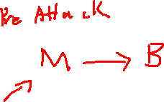
Question 5
Which key is used to encrypt the “Initial Traffic”?
Key k1, which is established in the first handshake.

Slide 20
Question 6
The second handshake is partially encrypted. Which key is used to encrypt the second handshake?
The previously established key k1 (from the first handshake).

Slide 21
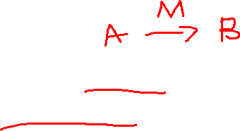
Question 7
Which key is used to encrypt the “Client Traffic”?
Key k2 established in the second handshake, which was completed before the Client Traffic is communicated.

Slide 22

Question 8
The vulnerability was discovered in 2009, and RFC 5746 was released in Feb 2010 to update the TLS/SSL protocol specification. Suppose that, sometime during late 2009, Alice uploaded her report via LumiNUS (during the “Client Traffic” in the renegotiation attack).
Would the confidentiality of the report being compromised under the attack?
No. The renegotiation attack on TLS does not compromise confidentiality. However, it may breach the integrity of TLS client-server communication.

Slide 23

Question 9
Bob was tasked with fixing the found vulnerability of the TLS protocol. Bob suggested the following:
In the original TLS’s handshake, the very first message was:
Client → Server: “Hello, I want to connect”.
Bob wanted to change the above to:
Client → Server: “Hello, I want to connect and this is the “x” handshake”.
where “x” can be first, second, and so on. Whenever the server notices an inconsistency, it must then immediately abort.

Slide 24

Question 9
Bob claimed that the above protocol modification would prevent the renegotiation attack. Show that Bob was wrong.
The attacker, as the man-in-the-middle (MITM), can simply change first in the unencrypted message to second.
Remember that initial handshakes are not encrypted!

Slide 25

Question 10
Bob realised the mistake. He noticed that in this attack, the client was the victim. So, he should give the victim the power to control the situation. In his second attempt, he then suggested the following:
In the original TLS’s handshake, the second message was:
Server → Client: “Ok, I am happy to connect. Here is my certificate and other information”.
Bob wanted to change the above to:
Server → Client: “Ok, I am happy to connect. Here is my certificate and other information. This is our “xth” handshake”.
where “x” can be first, second, and so on. Whenever the client notices an inconsistency, it must then immediately aborts.

Slide 26

Question 10
Show that Bob was still wrong…
Again, the attacker, Mallory, as the MITM, can also change second to first.
Remember that Mallory has the key to the first session, allowing her to decrypt the TLS handshake message sent by the server.

Slide 27
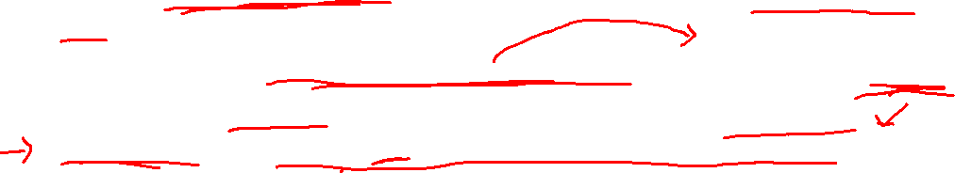
Question 11
Based on Bob’s second attempt, suggest a way to prevent the renegotiation attack.
We need to stop Mallory from modifying the messages! Need to preserve Integrity!
The server can sign the new message in Question 10 using its private key. Alternatively, if a secret key (K2) was previously established with the client, the server can MAC the new message in Question 10.

Slide 28

Question 12
While this instance of TLS performs a unilateral authentication, in many web applications, the clients still need to be authentication in some way.
In the pizza-shop application, how does the client get authenticated?
Most web applications perform an initial client authentication using a client’s username-password pair, and then subsequently persist that authentication state using a Session ID sent as a web/HTTP cookie.

Slide 29
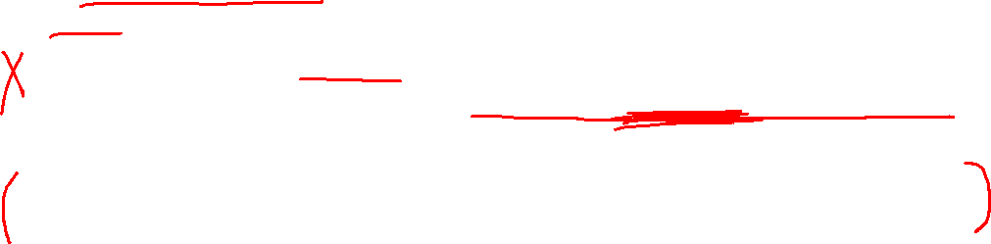
Question 13
You were the web application developer who built the pizza-shop online site. When the renegotiation attack was made known, you knew that your application was vulnerable to the attack.
Should you rely on the web server to fix and mitigate the attack (and thus you don’t have to do anything), or should you “harden” your web application by modifying it?
If you choose the latter, how should you prevent the attack? Recall that in the original application, the following is sent from the client’s browser: GET /pizza?toppings=pepperoni;address=attackersaddress HTTP/1.1 Cookie: victimscookie
What should be sent instead?

Slide 30

Question 13
The following are possible new message formats to be sent by Client:
(a) Two GET commands instead of one. The first GET command can just perform a dummy operation to be omitted.
=> This will neutralize the X-Ignore: section.
(b) The GET command includes (part of) the Session ID/Cookie for server’s verification
(c) The GET command includes a value that is derived from the Session ID, e.g. MAC of the GET command and the Session ID, for server’s verification

Slide 31
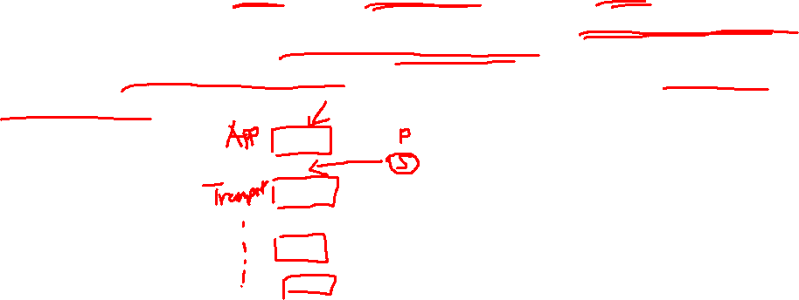
Question 13
Notice that any remedial solution from web developer would be messy. Also notice that, even if it works, the application now has to take care of communication security. This is not desirable since it is against the modularity principle of a good system design. That is, communication security is supposed to be handled by the layer below the application layer.

Slide 32

Question 14
When the renegotiation attack was made known, a very simple and effective suggested short-term fix was to disable the renegotiation in TLS.
Are there any implications/limitations to simply disabling the TLS renegotiation feature?
It will affect availability since some applications may need the renegotiation feature of the TLS protocol.

Slide 33

Thank you
Any questions?

